Slide 1

Culture in Business

Slide 2
  What is Culture?
Notes:
It can be positive and it can be negative
Culture evolves and changes
Culture is simply shared values and practices of the team
Culture varies from business to business
Culture lives in your business right now!

Slide 3
  How do you assess YOUR culture?
Notes:
Listen to your team members
Listen to your suppliers
Listen to your customers

Slide 4
  How do you change YOUR culture?
Notes:
Listen to your team members
Listen to your suppliers
Listen to your customers

Slide 5
How
Notes:
Here are some examples:
Mission clarity
Employee commitment
Fully empowered employees
High integrity workplace
Strong trust relationships
Highly effective leadership
Performance-based compensation and reward programs
Customer-focused
Effective 360-degree communications
Commitment to learning and skill development
Emphasis on recruiting and retaining outstanding employees
High degree of adaptability
High accountability standards
Demonstrated support for innovation

Slide 6

  Values Determine Culture
Notes:
What are the values in your business?
This is the core element of creating a culture.
These values MUST mean something to you.
You will be applying them daily to ‘build’ your company culture.
Understand it
Be able to explain it
Apply it
Live by it
Teach/preach it
Defend it
Demand it

Slide 7
  4 Key Areas to Create a
  Good Business Culture
Notes:
Team Ethos
Retail Relationships
Team Recruitment & Retention
You

Slide 8

  Team Ethos
Notes:
Pareto Principal
Why do they come to work?
What motivates them?
Why do you employ them?

Slide 9

  Retail Relationships
Notes:
Do you have an attitude of helping the customer?
Do you offer solutions or just create more problems for the customer?
Are you prepared to support them in their decisions?
How are they treated?
Is there an atmosphere where they feel like they want to ‘buy’ what you are selling?
It is not just about selling your product - you sell a lifestyle.
Do you give them a reason to return?

Slide 10

  Team Recruitment & Retention
Notes:
How robust is your hiring technique?
What is the criteria?
How do you determine if they will fit?
Are the duties outlined and written down?
Can you clearly detail what you expect/demand of your people?
How do you reward good work?
How do you celebrate with the team?
Do you celebrate your successes?

Slide 11

  You
Notes:
Are you happy doing what you are doing?
Do you love what you do?
Are you motivated by the small wins in the business and in your team?
Remember that you are a direct reflection of the business.

Slide 12
  Summary
Notes:
So far we have looked at:
Team culture in your business
What culture means to you and how you apply it
Breaking it down into 4 key areas
How you rate in each of those 4 areas
Now let’s look at what the culture in your business looks like!

Slide 13
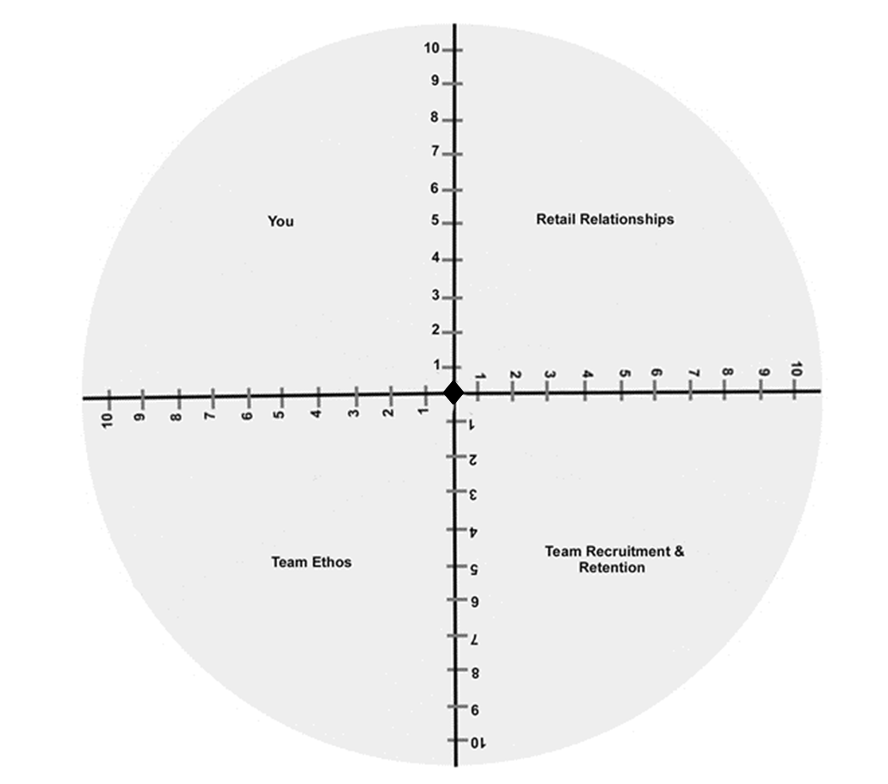
  Culture Wheel

Slide 14
Culture

