Slide 1



Slide 2

COMPLACENCY
Notes:
Complacency is a risk when there is no one
to keep you on your toes!

Slide 3
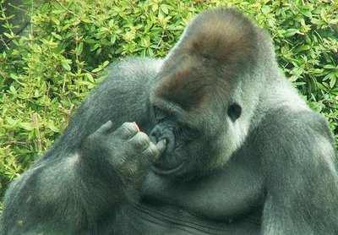
UNIQUE ADVANTAGES
Notes:
Carve Out Unique Advantages…

Slide 4

COMPLACENCY
Notes:
…And Guerilla Profits

Slide 5
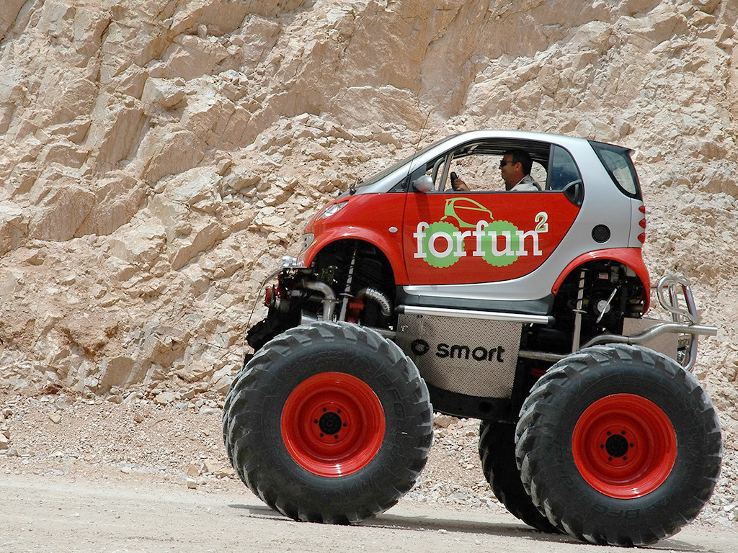
BE SMART
Notes:
…And Guerilla Profits

Slide 6
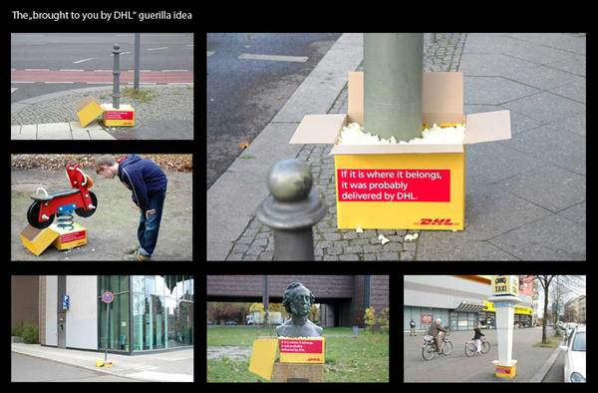
GUERILLA PROFITS
Notes:
…And Guerilla Profits

Slide 7

UNIQUE
Notes:
…What can make your business unique?
Initial contact
Presentation
Meeting needs & desires
Follow up
Problem handling
Intangibles

Slide 8
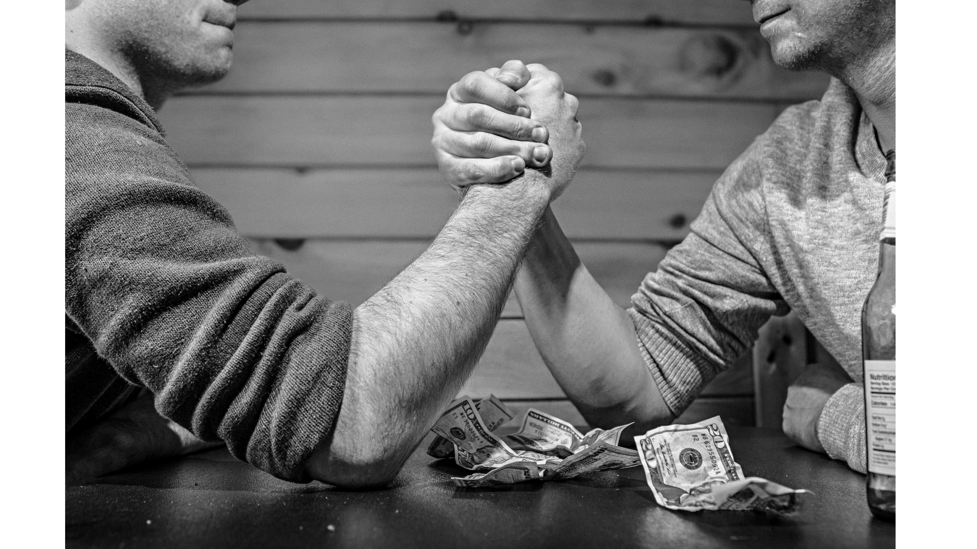
COMPETITION
Notes:
Why You Should Love Your Competition

Slide 9
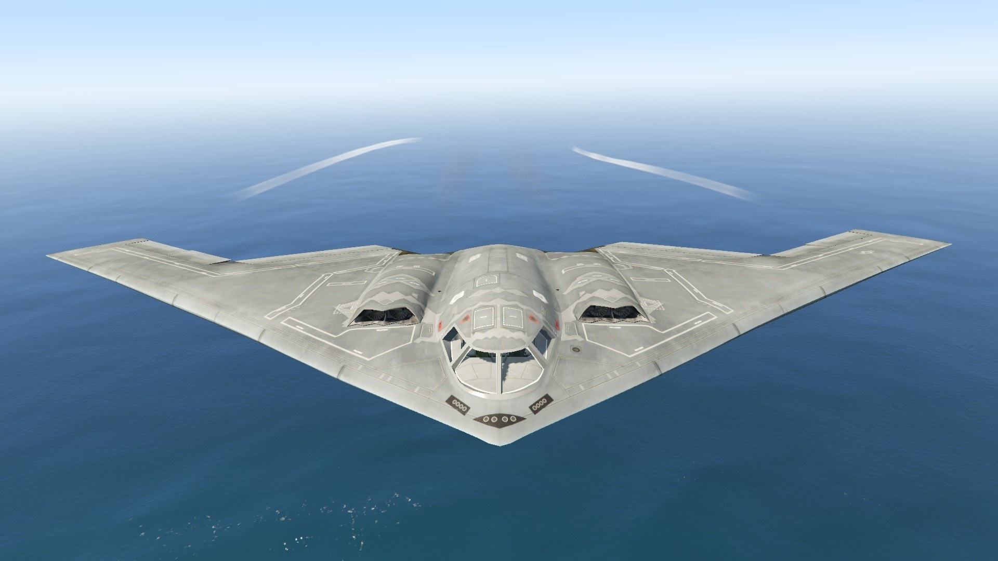
STEALTH MARKETING
Notes:
How to Grow Your Business Using Someone Else's Money! The Principles of Stealth Marketing
Principals of stealth marketing

Slide 10
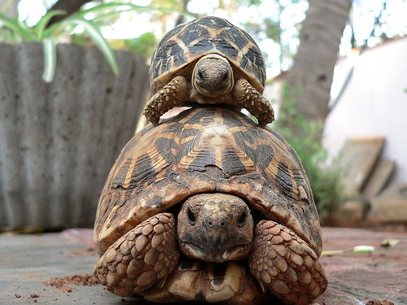
PIGGYBACK MARKETING
Notes:
Piggyback Marketing
TV
Radio
Newspapers
Magazines
Newsletters
Better Product

Slide 11
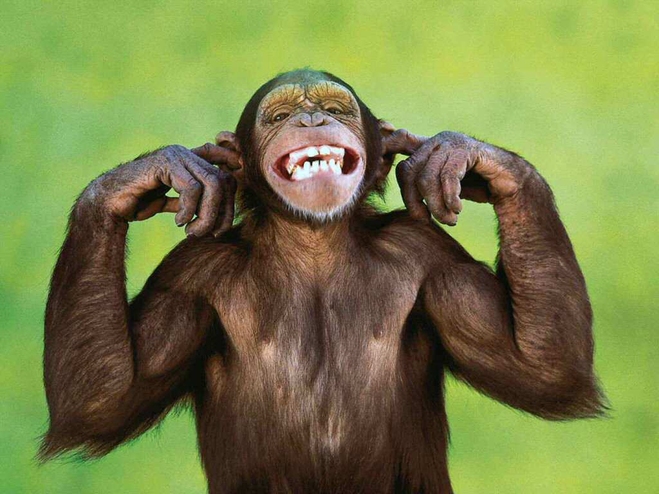
BE CHEEKY
Notes:
BE CHEEKY
THINK OUTSIDE THE SQUARE

Slide 12

REFERRALS
Notes:
The Essentials of A Referral System
Needs to be easy to be included
Easily explained
Simple to reward
Follow up
Track effectiveness

Slide 13

REFERRALS
Notes:
The Steps In Developing A Referral System
Step 1.
Who can refer to you?
Step 2.
How do you ask and get someone to refer to you?
Step 3.
How will you track the referral?
Step 4.
How will you acknowledge the referral?
How will you reward the referral?
Step 5.
How will you identify and acknowledge the referred customer?

Slide 14

ANOTHER ANGLE
Notes:
The Steps In Developing A Referral System
Lets look at referrals from another angele.

Slide 15

WHAT WE HAVE
Notes:
What if we offered to refer and took a share of the revenue?

Slide 16

OPPORTUNITIES
Notes:
What opportunities exist to give referrals?
Referral giving can be a long term arrangement … or part of a special offer.

Slide 17

THANK YOU
Notes:
Thanking For Referrals
Make it meaningful
i.e. Splurge item

Slide 18

INCENTIVES
Notes:
Mix Up The Incentives
That way you can:
Test and measure
Keep it fresh
Give them a choice
…And they may make an effort
Step 1.
Think of incentives.
Step 2.
Develop a multi step promotion.
announce and encourage
Step 3.
Set a timeframe.
by month
by season
maintain momentum
Step 4.
Give it a catchy name.
i.e. the perfect pool shop referral program
Step 5.
Conduct a Countdown.
bonus points
keep up the incentive
Remember…
HAVE FUN!

Slide 19

MARKETING
Notes:
Alliances
Gift of referrals
How many friends do you know.
Pre Sale Special
give a gift
capture data
Joint Venture Marketing
Joint marketing material
Joint Marketing Material
Joint workshops
Joint offers
Exchange services
Develop Your Own Program

Slide 20
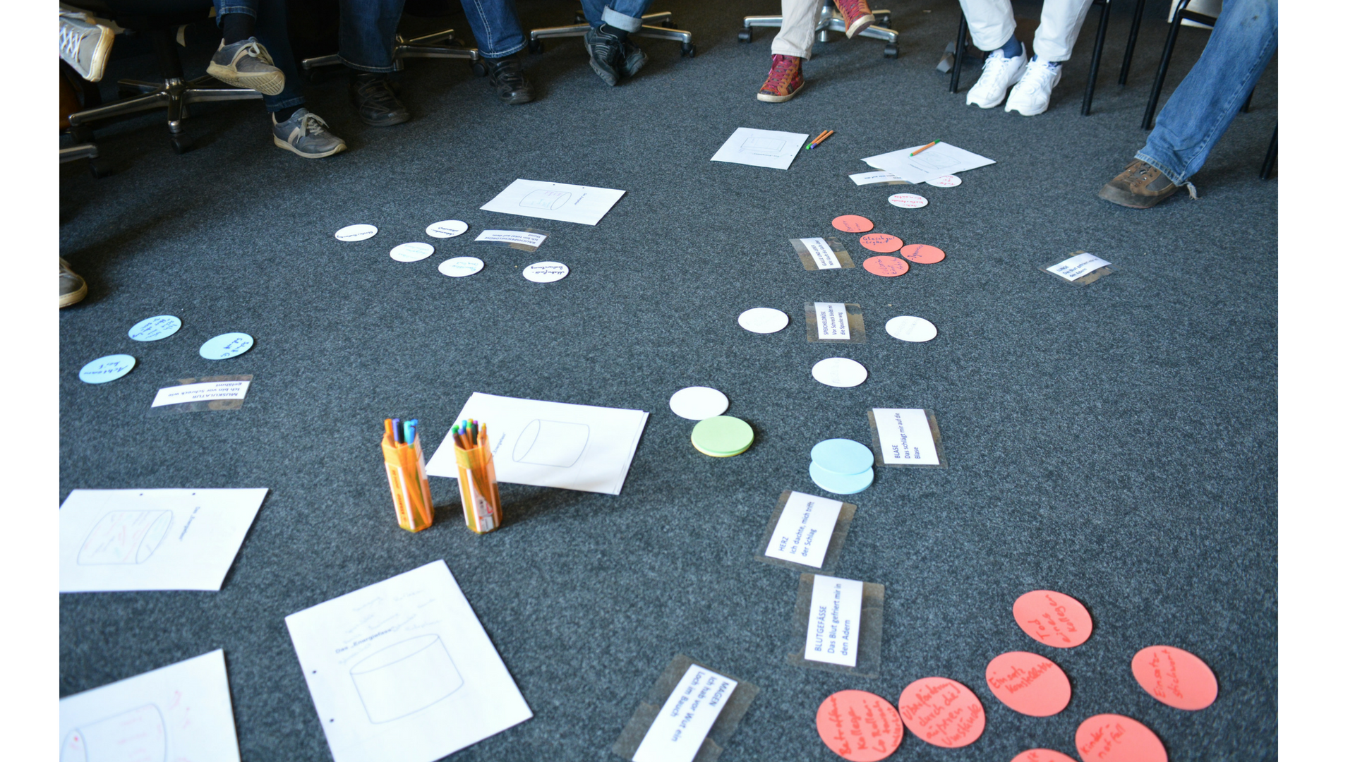
BRAINSTORM
Notes:
Let’s Brainstorm Some Alliance Concepts
Landscape Centre
Fencing Contractor
Mobile Lawn Mowing
Mechanic
Untapped Resources
Sell, Then Sell Again

Slide 21

CUSTOMER
Notes:
10 - 20% of people will buy something else
Removes buyer's remorse
Tends to reduce if not eliminate the threat of refunds
Reinforces the trust aspect of the relationship
Makes the customer more receptive to your next offer
Create an opportunity to offer a continuous or TFN buy
Creates an opportunity to solicit referrals and testimonials
Service & Repairs

Slide 22

HOLD
Notes:
On Hold & After Hours

Slide 23
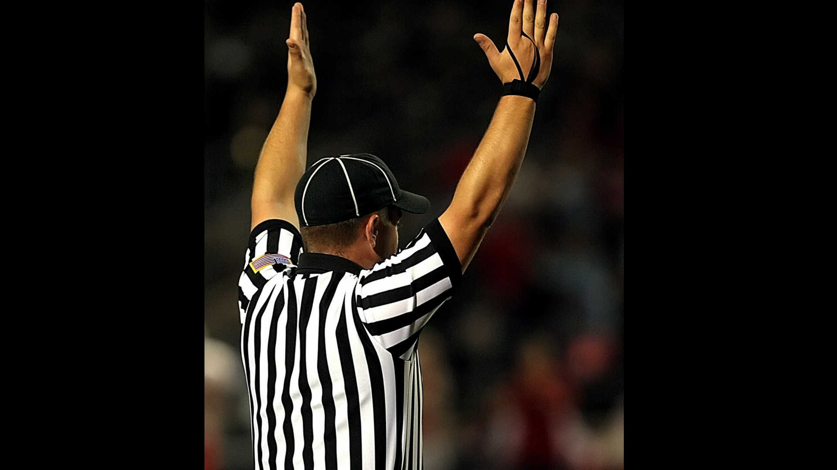
RULES
Notes:
Rules of the game
Elect a captain for your table.
You will choose (by draw) a business type.
Come up with 3 ways of establishing –
An Alliance
A Referral (to and/or from)
A Guerrilla Opportunity with that business
The judges will score your idea and you will be paid accordingly.
The team with the most money wins.

